Slide 1
Since apple all previous dynasties logo
team members : ChengHan
ChunJu
ChenBill
ChiuMiao
ShaoWei

Slide 2
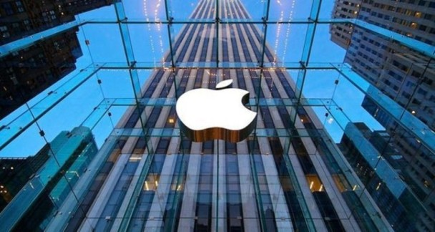
introduction
Apple's brand logo is recognized as one of the world's outstanding design. As an outstanding brand in the world, apple is in the leading position in the field of computer and personal digital. Apple products have won the love of hundreds of millions of users in the world with innovative ideas, excellent product design and excellent user experience.
Every time the logo of Apple changes, the core is the product change. Apple does not give up minimalism, but the core value of the brand is changing. So Apple's new logo may indicate the next core of development.

Slide 3
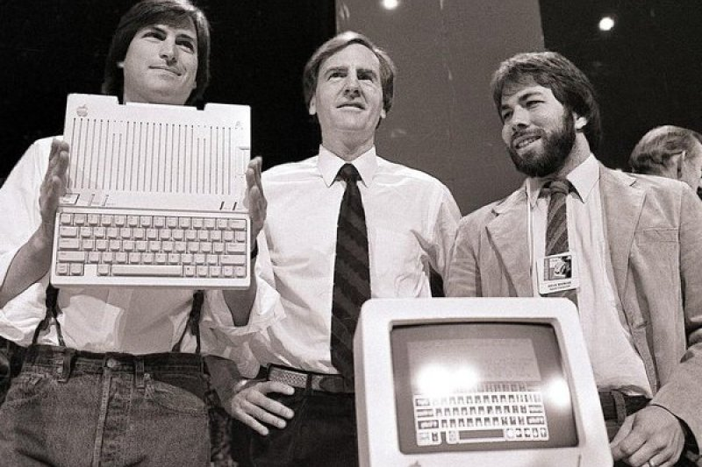
Origin of Apple
When Steve Jobs, Steve Woznik and Ronald Wayne decided to set up a company, Jobs came back from a trip, and he suggested to Wartz to name the company "Apple computer". The original logo was designed by Wayne, one of the three founders in 1976, and was only used in the production of the Apple I, a pen drawing for Newton sitting under the apple tree and reading a book. In 1976, Jobs decided to re-entrust the advertising design and use it with the release of Apple II. The logo was determined to use the iridescent apple image with a gap. This logo was used until 1998, when the iMac was released and changed to a two-color series. In 2007 it was again changed to metallic silver grey with shadows. It was changed to a flatter design in 2013 and has been used ever since.

Slide 4

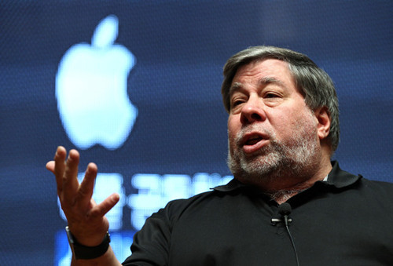
Apple Company origin
Apple was founded by Steve Jobs, Steve Wozniak, and Ronald Wayne in April 1976 to develop and sell Wozniak's Apple I personal computer, though Wayne sold his share back within 12 days. It was incorporated as Apple Computer, Inc., in January 1977, and sales of its computers, including the Apple II, grew quickly. Within a few years, Jobs and Wozniak had hired a staff of computer designers and had a production line. Apple went public in 1980 to instant financial success. Over the next few years, Apple shipped new computers featuring innovative graphical user interfaces, such as the original Macintosh in 1984, and Apple's marketing advertisements for its products received widespread critical acclaim. However, the high price of its products and limited application library caused problems, as did power struggles between executives. In 1985, Wozniak departed Apple amicably and remained an honorary employee,[8] while Jobs and others resigned to found NeXT.

Slide 5
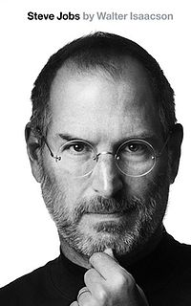
Apple Company origin
Consumers generally believe that Apple is an innovative, humane, and even a bit arrogant brand. But in Apple's own website, there is no clear description of its brand spirit. Perhaps Jobs once said that Apple is a creator of change in this world, but it is a description of the brand concept. Indeed, Apple's iPod, iPhone, and iPad have changed the rules of the industry's games and established its leading position in creating game rules.
I don't think that if Jobs left, Apple lost the brand spirit of innovation. If Apple's innovation is only based on Jobs, then this company and this brand will be difficult to become a great brand that can be passed on to the world. The spirit of a brand must be internalized in every employee. When employees in a company have the same belief, the brand spirit can be inherited.

Slide 6
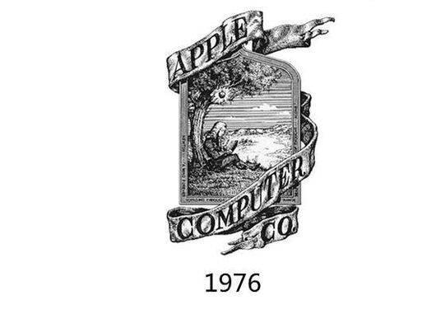
First generation of apple symbol(1976)
creator:Ron Wayne
inspiration source : It was inspired by Newton's discovery of gravity when he was struck by an apple in his meditation
Meaning behind :
The Apple Company is for the purpose of with the aid of this logo indicating the apple also wants to imitate Newton to devote to innovate, makes the change world the action. But but the apple first generation of logo image too is really complex, although the color only then the black and white two kinds, may remember very difficultly by the human, therefore arrived the second year on by the apple abandonment.
this is the apple first generation of trademark only then black and white moreover difficult to record therefore only used for a year to abandon

Slide 7
Second generation of apple symbol(1977-1998)
creator:Regis McKenna advertisement design company
Meaning behind :
Uses second generation of logo the reason to come from Apple Company's another founder - - Steve · Jia Burse. Steve · Jia Burse needs to issue section new product - - Apple II, but original marking too is obviously complex, the formerly first generation of logo image was very difficult to continue to graft on the new product.
But Apple II used the brand-new revertex outer covering material quality, the screen also turned colored. Thus urgently needs an image to be simple at this time, has the characteristic brand to symbolize, thus enhances Apple II distinguishes the insight.
Therefore, Steve · Jia Burse had found Regis the McKenna advertisement design company, hoped they can solve this difficult problem, designs the brand-new logo image for the Apple Company.

Slide 8
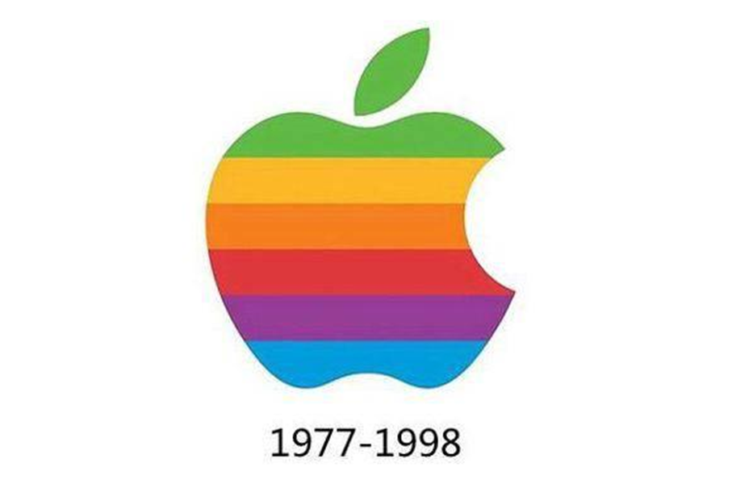
Second generation of apple symbol(1977-1998)
Finally, that is nipped a apple image to be born, following also had has filled the charm color pigment figure, let the human think has filled the affinity. However, most started, this Logo by Apple Company own approval, in some instruction booklets, on the knapsack still is not being printed the integrity colored apple. Above Logo colored represents Apple II to be able the color display, simultaneously this color also analogies becomes the apple murky time staff blood. This second generation of logo image continued to use continuously to 1998, until only then made the change at the iMac release conference.

Slide 9
Second generation of apple symbol(1977-1998)
Apple is a long-lasting, eternal rumor, and there are several legends about this bite：
1、”咬” English is bite, with computer data quantity unit “byte” English Byte unison, therefore, the implication company and the computer are related.
2、For commemoration modern computer technology founder - - turing. Because he is after ate one to moisten has the cyanide apple to die.
3、 Steven Paul Jobs in once has said before death, “because Logo is very small, is nipped a design only was in order to let it look like does not look like a cherry”

Slide 10
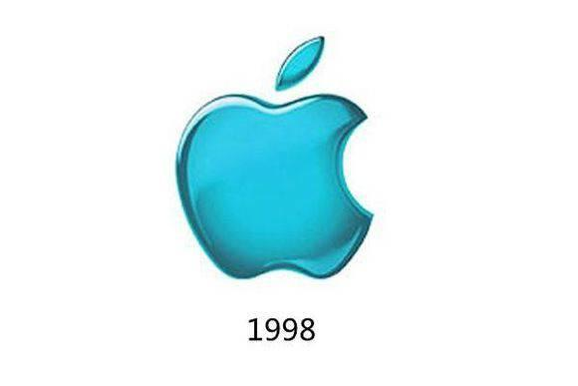
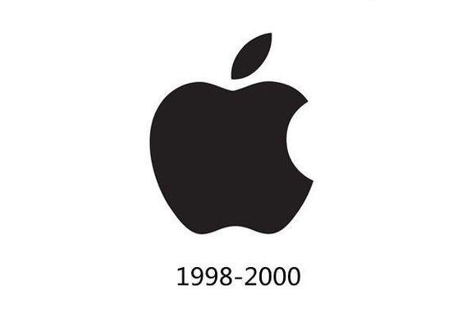
Third generation apple symbol(1998-2000)
Meaning behind :
This logo image change reason is because the new product uses the transparent material quality outer covering, in order to coordinate the new product the hand to grasp the sense of reality to make the corresponding change, the logo image uses the brand-new translucent revertex. Therefore, logo color also changed into a simple monotone, intended to reflect a simple beauty of apple monochrome logo is still in use, it is the most can reflect the brand positioning of apple logo

Slide 11
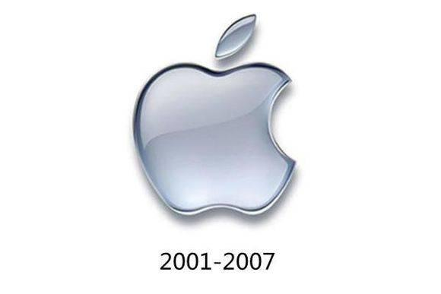
Fourth generation of apple symbol(2001-2007)
Meaning behind :
The apple logo image becomes thoroughly the transparency color, its main purpose coordination promotes the market for the first time Mac the OS X system.This apple brand core value transforms by the computer into the computer work system, therefore the apple logo image also followed the computer work system, the interface style, uses thoroughly the brilliant color the sense of reality.To in 2007, when the apple promoted the iPhone handset, also in one time has replaced the logo image

Slide 12
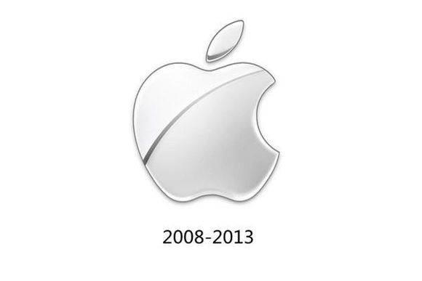
Five generation of apple symbol(2008-2013)
Meaning behind :
The five dynasties produce the reason is because iPhone creatively has introduced the Multi-touch touching screen technology, has brought the brand-new user experience. Therefore, the apple logo image needs to use the glass sense of reality, therefore the subject color changes the silver-white color, represents the Apple Company to provide succinctly, the most convenient service as the user, here the apple handset said goodbye half screen age, the wisdom handset time approached.

Slide 13
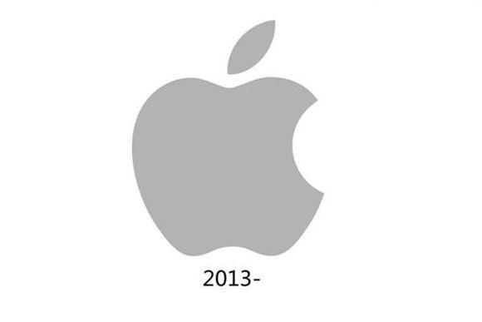
Sixth generation of apple symbol(2013-now)
Meaning behind :
In 2013, the apple design style has the significant transformation. Jony Ive starts the bold innovation, the iOS system in high light, the shadow, the halo and so on the three-dimensional element all gets rid of, system interface thorough flat. One of as design style adjustments, apple logo has also had the change, the three-dimensional element is removed, presents the succinct pure white flat effect.

Slide 14
Conclusion
Today, the apple logo is the innovation and the trust symbol.But regardless of how the surface contours does adjust, the apple logo basic outline is constant, since just like they persisted continuously the technical innovation, forever walks in technical front end.
Finally, hoped above knowledge has enriched you to the apple logo history understanding.
Source :https://kknews.cc/zh-tw/tech/6rkmrm.html
https://kknews.cc/zh-tw/tech/pkar8qp.html
https://en.wikipedia.org/wiki/Apple_Inc.

